Slide 1
Further MATLAB Programming – Make Your Code Efficient and Robust
Louise Brown, Yijie (Amy) Zheng

Slide 2
Version Control
It’s all gone horribly wrong!
Does this look familiar?
TestCode.m
TestCode_data_set1.m
TestCode_data_set1_v2.m
TestCode_data_set1_v2_with_output.m
Use version control, eg Git, Subversion or Mercurial

Slide 3
Git Workflow
It’s all gone horribly wrong!
5
8
10
Discontinued branch
Branch
2
3
6
7
1
4
9
Trunk
T1
Tag
T2
Tags can correspond to code producing results for research papers

Slide 4
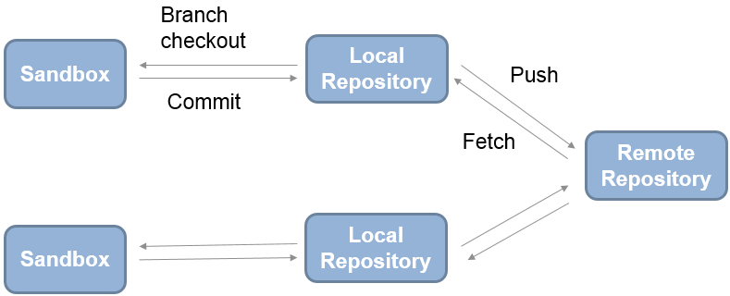
Git Workflow
Or working folder
GitHub
Use git in MATLAB: https://uk.mathworks.com/help/matlab/matlab_prog/use-git-in-matlab.html

Slide 5
Clone Course Materials
louisepb/Nottingham_Workshop on GitHub
Clone the repo into BootCampFiles folder
Run setupPath.m
Notes:
Try
Might want different configurations for different computers, no of screens etc

Slide 6
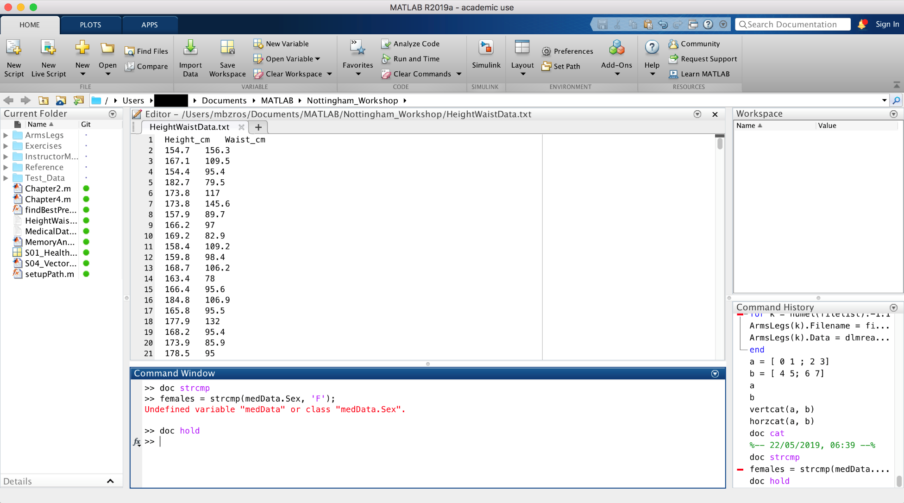
The MATLAB Desktop
Notes:
Try
Might want different configurations for different computers, no of screens etc

Slide 7
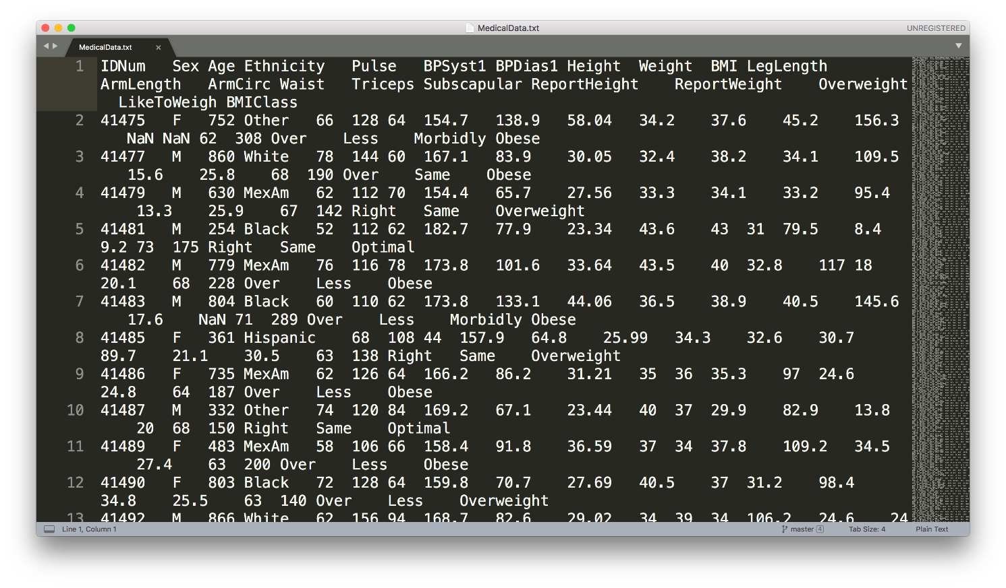
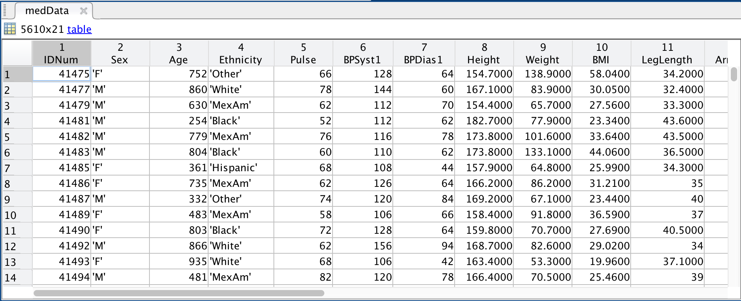
Heterogeneous data
doc readtable

Slide 8
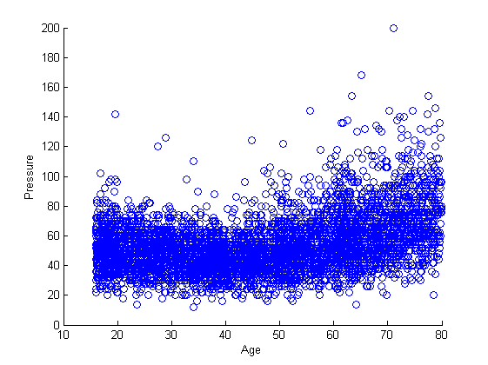
Plotting vectors
figure % new figure
% basic plot
scatter(medData.Age, medData.BPDiff)
xlabel(‘Age’)
ylabel(‘Pressure’)

Slide 9
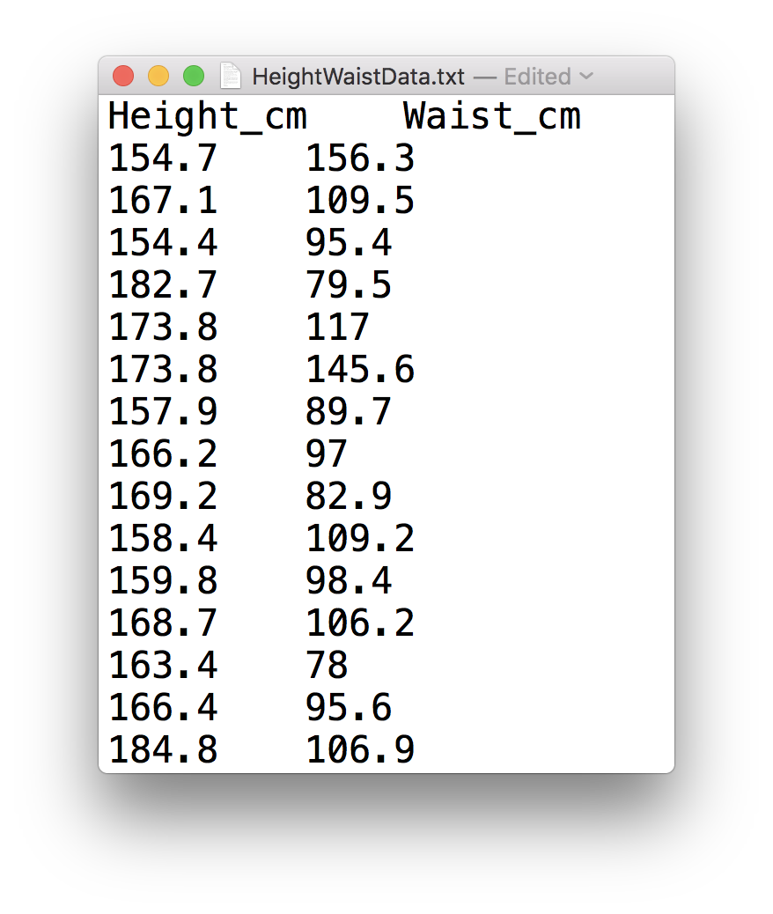
Low-Level file I/O
fileID = fopen(‘HeightWaistData.txt’);
dataFormat = ‘%f %f’;
heightWaistData = textscan(fileID, dataFormat, ...
‘HeaderLines’, 1, ‘Delimiter’, ‘\t’);
fclose(fileID);

Slide 10
Cell array
A cell array is a data type with indexed data containers called cells, where each cell can contain any type of data.
C = {1, 2, 3; 'text’, rand(5, 10, 2), {11; 22; 33}}
C = {'2017-08-16',[56 67 78]};
C(2,:) = {'2017-08-17',[58 69 79]};
C(3,:) = {'2017-08-18',[60 68 81]};

Slide 11
Converting cell arrays to array
All elements of a MATLAB array must be the same type.
hw = cell2mat(heightWaistData)
height = hw(:, 1);
waist = hw(:, 2);
% accessing data in arrays
array name( first row : last row, first column : last column)

Slide 12
Missing data and Boolean values
a = [ 0 1 1 2 3 5 8 ];
a( [ true true false false true false true ] )
>> [ 0 1 3 8 ] % only shows the values for indices equal True
a = [ 1 3 NaN 7 NaN NaN 17 ]
isNaN(a)
>> [ false false true false true true false ]
a ( ~ isnan ( a ) )

Slide 13
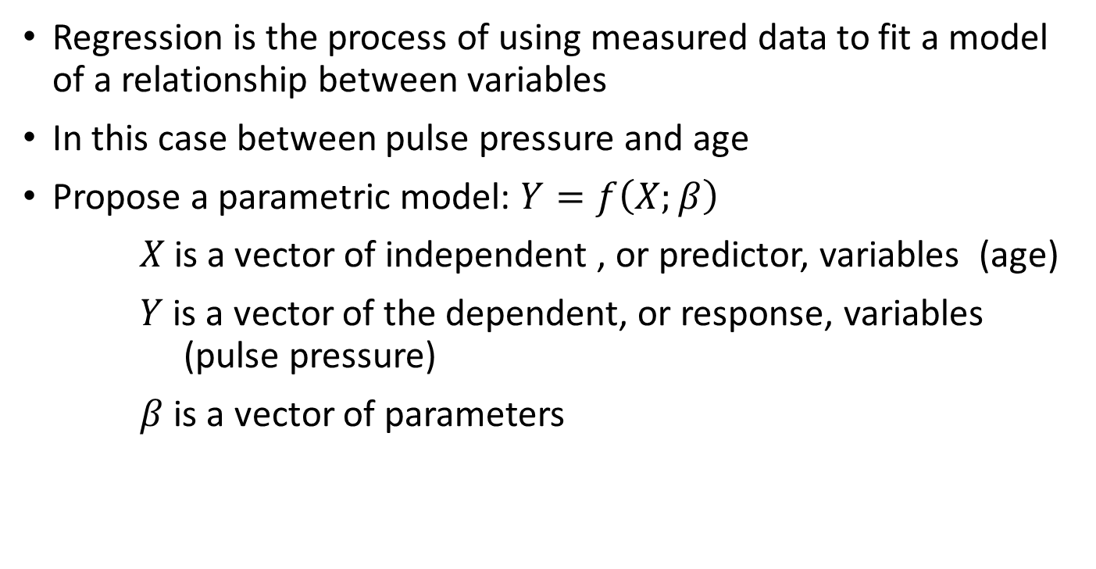
Linear Regression Models
Regression is the process of using measured data to fit a model of a relationship between variables
In this case between pulse pressure and age
Propose a parametric model: $Y=f\left(X;β\right)$
$X$is a vector of independent , or predictor, variables (age)
$Y$ is a vector of the dependent, or response, variables (pulse pressure)
$β$ is a vector of parameters

Slide 14
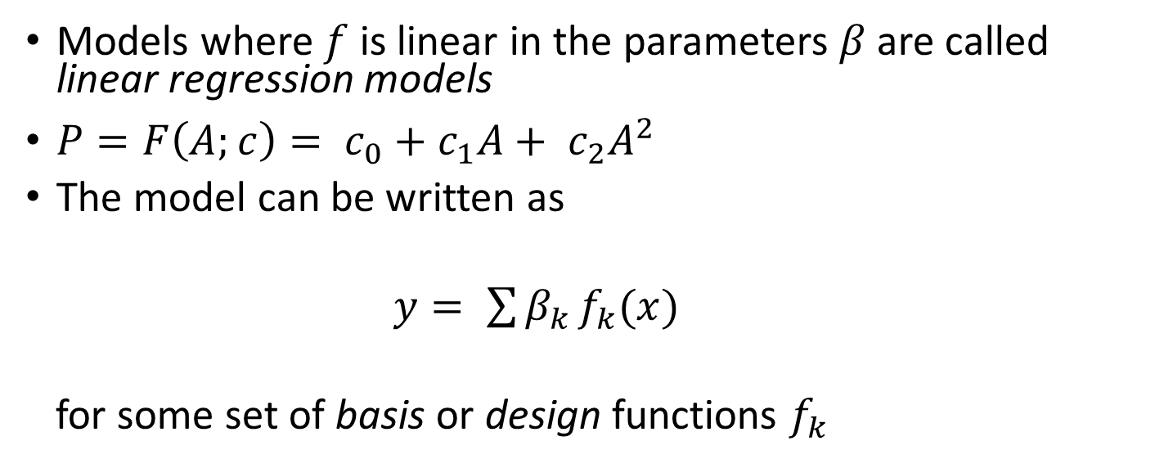
Linear Regression Models
Models where $f$ is linear in the parameters $β$ are called linear regression models
$P=F\left(A;c\right)= c_{0}+c_{1}A+ c_{2}A^{2}$
The model can be written as
$y= \sum{β_{k }f_{k}(x)}$
for some set of basis or design functions $f_{k}$
Response
Predictor
Model parameters
Design functions

Slide 15

Matrix Equations
Fitting n measured data points gives a system of n linear equations with m unknown model parameters (c_{j})
$$y_{1} = c_{1}f_{1}\left(x_{1}\right)+ c_{2}f_{2}\left(x_{1}\right)+ …+c_{m}f_{m}(x_{1})$$
$$y_{2} = c_{1}f_{1}\left(x_{2}\right)+ c_{2}f_{2}\left(x_{2}\right)+ …+c_{m}f_{m}(x_{2})$$
$$⋮$$
$$y_{n} = c_{1}f_{1}\left(x_{n}\right)+ c_{2}f_{2}\left(x_{n}\right)+ …+c_{m}f_{m}(x_{n})$$
Using matrix algebra, this system can be written in matrix-vector form as:
$$y_{1} = f_{1}\left(x_{1}\right) f_{2}\left(x_{1}\right) …{ f}_{m}\left(x_{1}\right){ c}_{1}$$
$$y_{2} = f_{1}\left(x_{2}\right) f_{2}\left(x_{2}\right) …{ f}_{m}\left(x_{2}\right){ c}_{2}$$
$$⋮$$
$$⋮$$
$$⋮$$
$$⋱$$
$$⋮$$
$$⋮$$
$$y_{n} = f_{1}\left(x_{n}\right) f_{2}\left(x_{n}\right) …{ f}_{m}\left(x_{n}\right){ c}_{m}$$

Slide 16
Anonymous Functions
Anonymous functions are local functions only available until the workspace is cleared. They are called anonymous because they do not refer to a named function.
Fnhandle = @ (input arguments) functioncode;
Shows function handle being created
Can be saved in .mat file using load and save commands
f = @(x,y) sin(x) + y
>> f(pi/6, 0.5)
ans =
1
Notes:
Bit like an inline function
Show creating polynomial poly = @(x) 4*x.^2 + 3.*x + 7

Slide 17
Anonymous Functions
Anonymous function creating function handle
modelFun = @(c, x1, x2) c(1)+c(2)*x1+c(3)*x2c(4)*x1.^2 + ...
c(5)*x2.^2 + c(6)*x1.*x2;
Mathematical notation
f(x1, x2) = c(1) +c(2)*x1 +c(3)*x2 + c(4)*x1.^2 + ...
c(5)*x2.^2 + c(6)*x1*x2

Slide 18
Making Grids
The meshgrid function converts vectors of points into matrices that can represent a grid of points in the x-y plane
>> x = -2:4; % 1 x 7 vector
>> y = 0:5; % 1 x 6 vector
>> [X,Y] = meshgrid(x,y)
X =
-2 -1 0 1 2 3 4
-2 -1 0 1 2 3 4
-2 -1 0 1 2 3 4
-2 -1 0 1 2 3 4
-2 -1 0 1 2 3 4
-2 -1 0 1 2 3 4
Y =
0 0 0 0 0 0 0
1 1 1 1 1 1 1
2 2 2 2 2 2 2
3 3 3 3 3 3 3
4 4 4 4 4 4 4
5 5 5 5 5 5 5
42 points in grid of points in the x,y plan
x coordinate at each grid point
y coordinate at each grid point

Slide 19
Creating a Function
Must have function declaration on line 1 of file
Must be the same as the filename – fitQuadModel.m
Output arguments
Input arguments
function [modelCoeffs, fh] = fitQuadModel(X, y, showplot)
% FITQUADMODEL Fits a quadratic model to the response data
% using the columns of X as regressors. X has one or two
% columns; y is a vector with the same number of rows as X.
Notes:
Built up basics to be able to write code
Need the tools to be able to write well constructed programs
Good practice to include H1 line to show input/output arguments
Dummy arguments are basically templates

Slide 20
Debugging and Improving Performance
Diagnosing problems
Identifying common errors
Evaluation of code performance
Vectorisation techniques
Managing memory effectively

Slide 21
Preallocation of Memory
Efficient matrix and array operations rely on data being located together in a contiguous block of memory addresses
Create a dummy version of a variable of appropriate size
>> A = zeros(m,n)
Subsequent operations then overwrite the zeros with the required values
Assigning the last element of an array first creates an array of the appropriate size
>> x(8) = 3
x =
0 0 0 0 0 0 0 3

Slide 22
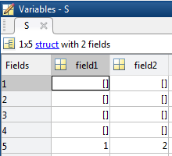
Preallocating Cells and Structures
Cell arrays and structure arrays act as containers for various types of data
>> c = cell(1,5)
The cell command preallocates the container
c
Define the last element in a structure array
>> S(5).field1 = 1;
>> S(5).field2 = 2;

Slide 23
In-Place Optimisation
In-place optimisation saves on memory by reusing an input variable for output
y = 2*x + 3;
x = 2*x + 3; Saves memory by assigning back into variable x and execution time for allocating memory
Functions
....
x = myfun(x)
....
Regular Function
In-Place Optimisation
Function y = myfun(x)
y = 2*x + 3;
Function x = myfun(x)
x = 2*x + 3;
x
myfun
y
x
myfun

Slide 24
Before you leave, please complete the online course evaluation
To access the evaluation form visit:
https://nottingham.onlinesurveys.ac.uk/graduate-school-course-evaluation-survey
or using
http://tiny.cc/gradschooleval
Input the course date as 23/05/2019
Input the course code as GSTML3

